Slide 1

MARKET STRUCTURES
Oyugi J.Nyanjong’
ECONOMICS DEPT
Twitter: @ohyouguy

Slide 2
Market Structures definition
the interconnected characteristics of the market.

Slide 3
Market x-stics
Include:
The number & relative strength of buyers and sellers
The degree of connection amongst buyers and sellers
The level and forms of competition within markets
The extent of product differentiation
The ease of entry into and exit from the market

Slide 4
Market Power
Useful in delineating the various forms of market structures.
is the ability of a firm or an industry to raise prices without losing all the quantity demanded to their goods and services.
PC markets have zero market power, Monopolies the greatest market power.

Slide 5
Types of market structures
Perfectly competitive markets-Many buyers, many sellers
Monopolistically competitive markets-Product differentiation
Monopolies-single seller of pdt with no close substitutes
Oligopolies.X-rized by few sellers with significant market share.

Slide 6
Perfect Competition
Characteristics:
infinite number of buyers and sellers
Perfect factor mobility
sole objective for PC firm is profit maximization
Constant Returns to Scale
no barriers of entry and exit

Slide 7
Perfect Competition x-stics
Product homogeneity-no consumer preference can be inferred
Zero transaction costs.
Perfect information-buyers and sellers all have the same information in regard to the price, quality and availability of a good or service.

Slide 8
PERFECT COMPETITION
Examples of PC mkts include:
Financial markets – stock exchange
Agricultural markets
Internet e.g. eBay

Slide 9
PERFECT COMPETITION
Is the most efficient form of a market structure. This is because PC market results in:
Efficient allocation of resources among firms
Efficient distribution of goods and services amongst households
Efficient mix of output amongst firms

Slide 10
MONOPOLY
is defined as an industry with the following attributes:
A single firm that produces a good or service for which there are no close substitutes .
significant barriers to entry prevents other firms from entering the industry to compete for profits.

Slide 11
MONOPOLY
Firms that already have market power can maintain it either by
preventing other firms from producing an exact replica of the product, or;
preventing other firms from entering the market.

Slide 12
BARRIERS TO ENTRY
Def: circumstances that prevent or greatly impede a potential competitor's entry into the market or ability to compete in the market.
Barriers may either be
Economic
Legal

Slide 13
ECONOMIC BARRIERS
Economies of Scale : Some products can only be produced efficiently only in large capital intensive production facilities.
Ownership of scarce factor of production e.g.mining
Technological superiority: A monopoly may be better able to acquire, integrate and use the best possible technology in producing its goods while entrants do not have the size or financial muscle to use the best available technology

Slide 14
LEGAL BARRIERS
Government franchises – monopoly by government directive e.g. provision of public utility e.g. KPLC,water provision
Patents – a barrier to entry that grants exclusive use of the patented products or process to the inventor.

Slide 15
MONOPOLISTIC COMPETITION
Formulated by the Seminal work, “Theory of Monopolistic Competition” by Chamberlain E.H..(1932).
is a form of imperfect competition where many competing producers sell products that are differentiated from one another (that is, the products are substitutes, but, with differences such as branding, are not exactly alike).

Slide 16
Product Differentiation
– is a strategy that firms use to achieve market power and which is accomplished by firms producing goods and services that are distinctive, and provide a positive identity(attribute) in consumers’ mind.
achieved through advertising.

Slide 17
MONOPOLISTIC COMPETITION x-stics
firms take the prices charged by its rival as given but ignore the impact of its own prices on the prices of other firms(Unlike oligopolies).
There are many producers and many consumers in a given market, and no business has total control over the market price (Unlike monopolies).

Slide 18
MONOPOLISTIC COMPETITION x-stics
Consumers perceive that there are non-price differences among the competitors' products.
Distinction will be w.r.t type, style, quality, reputation, appearance, and location.

Slide 19
MONOPOLISTIC COMPETITION x-stics
Perfect information.
There are few barriers to entry and exit.
Producers have a degree of control over price.

Slide 20
INEFFICENCY IN MC MARKETS
Due to:
Advertising distorting the price mechanism.-thro creation of brand names.
High transaction costs compared to other market structures.
P<MC in the long run.

Slide 21
EXAMPLES OF MC MARKETS
Restaurants.
Detergent co.
Computer co
Clothing co.
Shoe co (thru’ sponsorship deals with Messi, Lebron, etc)
Publishing co.
Furniture co..

Slide 22
Oligopoly definition
Name derived from the Greek word, “Olig” meaning “few”.
Oligopoly is a market structure featuring a small number of sellers that together account for a large fraction of market share.

Slide 23
Types of oligopoly: Pure oligopoly
Product sold is homogeneous, implying that market power is derived from the fact that there is lack of competition.(hence pure in that sense)
(e.g. extractive(Steel, cement, copper)industries)

Slide 24
Types of oligopoly Impure oligopolu
Product sold is differentiated, implying that market power is derived from both the lack of competition and product differentiation.
(e.g. auto industries, airlines, electrical appliances)

Slide 25
Features of oligopoly continued
few firms
either homogeneous or differentiated products
interdependence of firms - policies of one firm affect the other firms
High degree of collusion in setting of prices
substantial barriers to entry
Repeated interactions between firms

Slide 26
Collusion and Competition
Oligopoly firms may collude (act as a monopoly) and earn positive profits.
OR
Oligopolists may compete with each other and drive prices down to zero economic profits.

Slide 27
Cheating is good
While it pays for firms to collude, in order to earn positive profits, it also pays to cheat on the collusive agreement. If one firm cuts its price to slightly below the others, it could gain a lot of business.
If everyone cheats on the agreement, however, the agreement falls apart.

Slide 28
Collusive agreements less likely to succeed when
secret price cuts are difficult and costly to detect. (Quality changes are difficult to monitor.)
market conditions are unstable. (Differences in expectations make it difficult to reach an agreement.)
vigorous antitrust action increases the cost of collusion.

Slide 29
Sticky Prices
One characteristic of informal collusive behavior is that prices tend to be sticky – they don’t change frequently

Slide 30
Reasons for sticky prices
Informal collusion is an important reason why prices are sticky
Another is the kinked demand curve
If a firm increases price, others won’t go along, so demand is very elastic for price increases
If a firm lowers price, other firms match the decrease, so demand is inelastic for price decreases

Slide 31
Reasons for sticky prices continued
long-term contracts between firms and customers
menu costs
firms not wishing to annoy customers with frequent price changes
Assumption:
Firms set their own prices (i.e., firms have some market power)

Slide 32
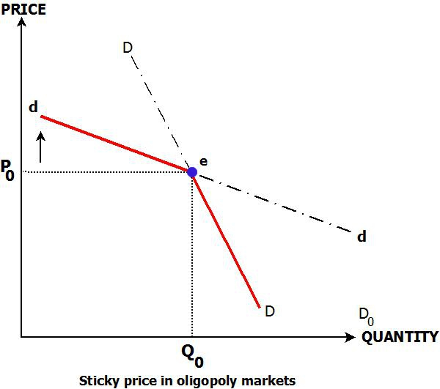
Sticky Price leads to Kinked dd curves

Slide 33
Π MAXIMIZATION IN PC MARKETS
Key concepts:
Total Revenue (TR) –total receipts from a firm’s sales within a specified period of time.
TR = Price(P)XQuantity sold(Q)
Average revenue (AR) – are the total receipts divided by the number of unit of a good or service sold.
AR =TR/Q P.Q/Q=P

Slide 34
Π MAXIMIZATION IN PC MARKETS
Marginal revenue (MR) – this is the additional revenue accruing from sales of an additional unit of a good or service.
Profit is maximized at the point where;
P = MR = MC

Slide 35
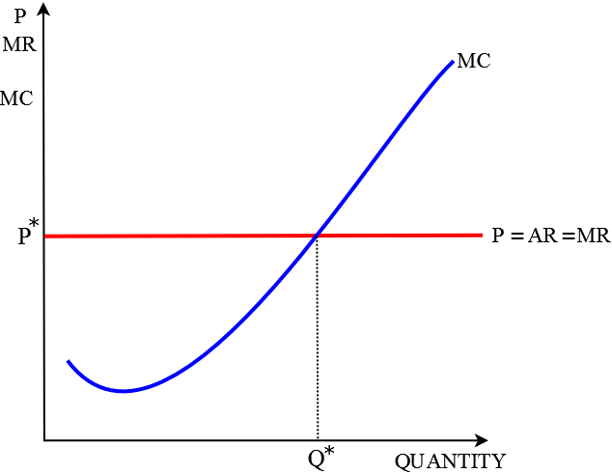
PROFIT MAXIMIZATION IN PC MARKETS

Slide 36
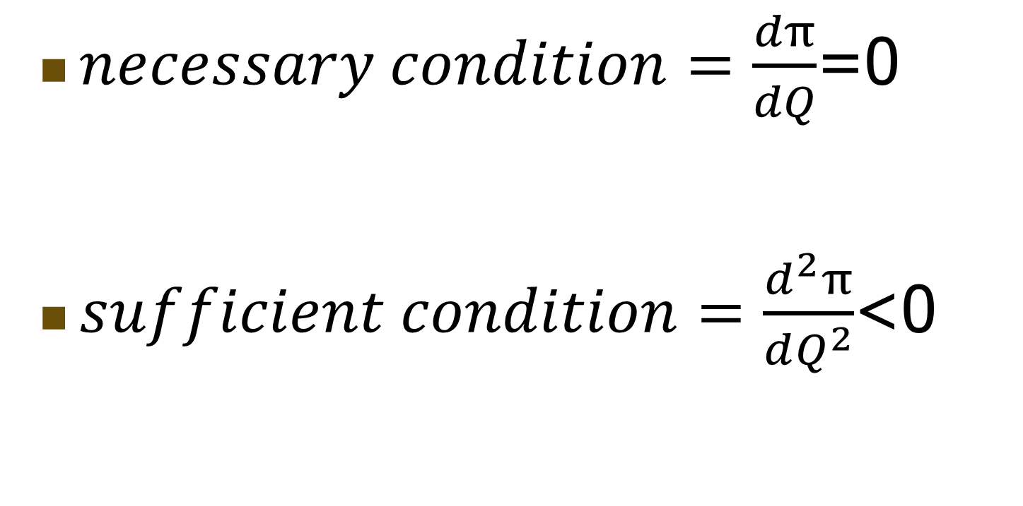
Π Maximization: Necessary & Sufficiency Conditions
$necessary condition=\frac{dπ}{dQ}$=0
$sufficient condition=\frac{d^{2}π}{dQ^{2}}$<0

Slide 37

Numerical example
XYZ Ltd, operates in a perfectly competitive market producing laptops. The firm’s total revenue and total cost functions are, respectively,
$TR=5,000+100Q−6Q^{2}$
$TC=2,500+44Q−2.5Q^{2}$
Required
Determine the profit maximizing level of output, and price
Determine the firm’s maximum profit

Slide 38
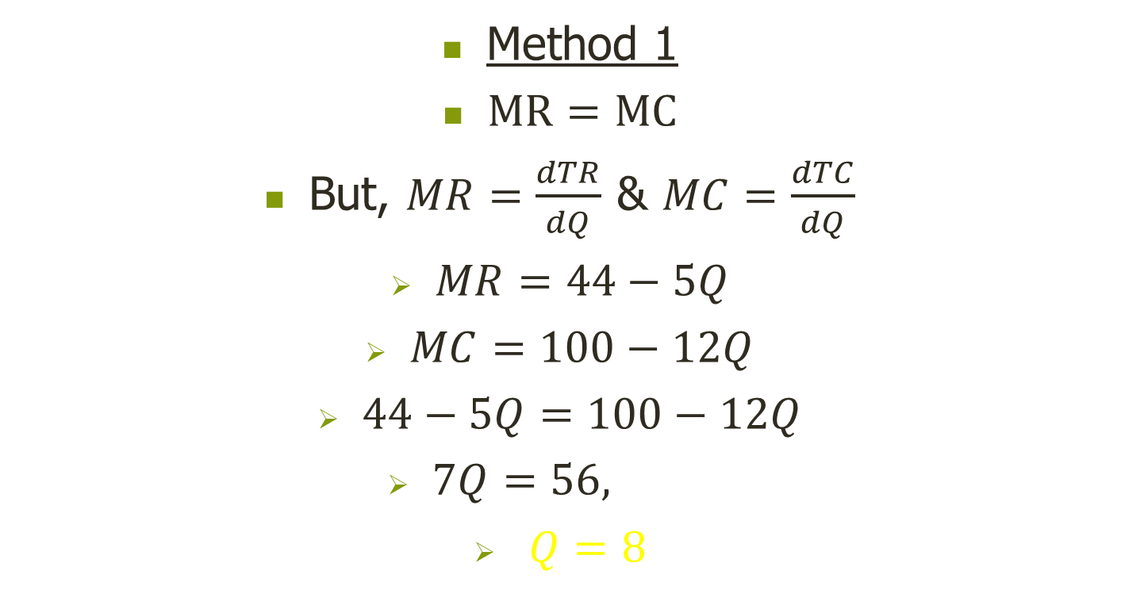
Numerical example: solution
Method 1
$MR=MC$
But, $MR=\frac{dTR}{dQ}$ & $MC=\frac{dTC}{dQ}$
$MR=44−5Q$
$MC=100−12Q$
$44−5Q=100−12Q$
$7Q=56,$
$Q=8$

Slide 39
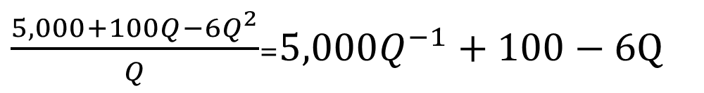

Numerical example: solution
Recall: $AR=P=\frac{TR}{Q}$
$AR=5,000{∗8}^{−1}+100−6∗8$
$P=677$
$\frac{5,000+100Q−6Q^{2}}{Q}$=$5,000Q^{−1}+100−6Q$

Slide 40
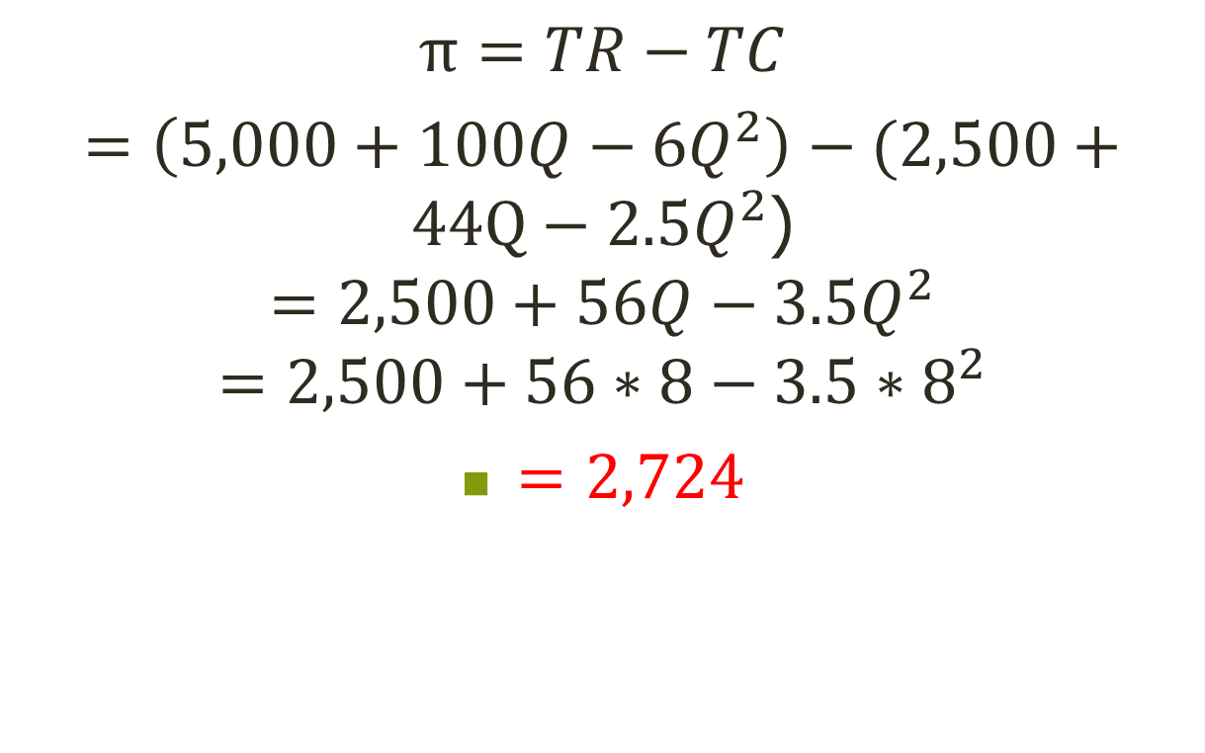
Numerical example: solution
$$π=TR−TC$$
$=\left(5,000+100Q−6Q^{2}\right)−(2,500+44Q−2.5Q^{2}$)
$$=2,500+56Q−3.5Q^{2}$$
$$=2,500+56∗8−3.5{∗8}^{2}$$
$=2,724$

Slide 41
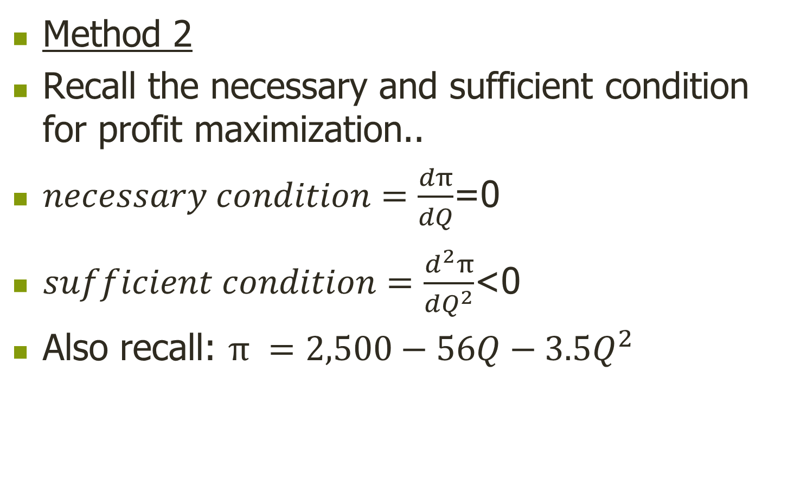
Numerical example: solution
Method 2
Recall the necessary and sufficient condition for profit maximization..
$necessary condition=\frac{dπ}{dQ}$=0
$sufficient condition=\frac{d^{2}π}{dQ^{2}}$<0
Also recall: $π =2,500−56Q−3.5Q^{2}$

Slide 42
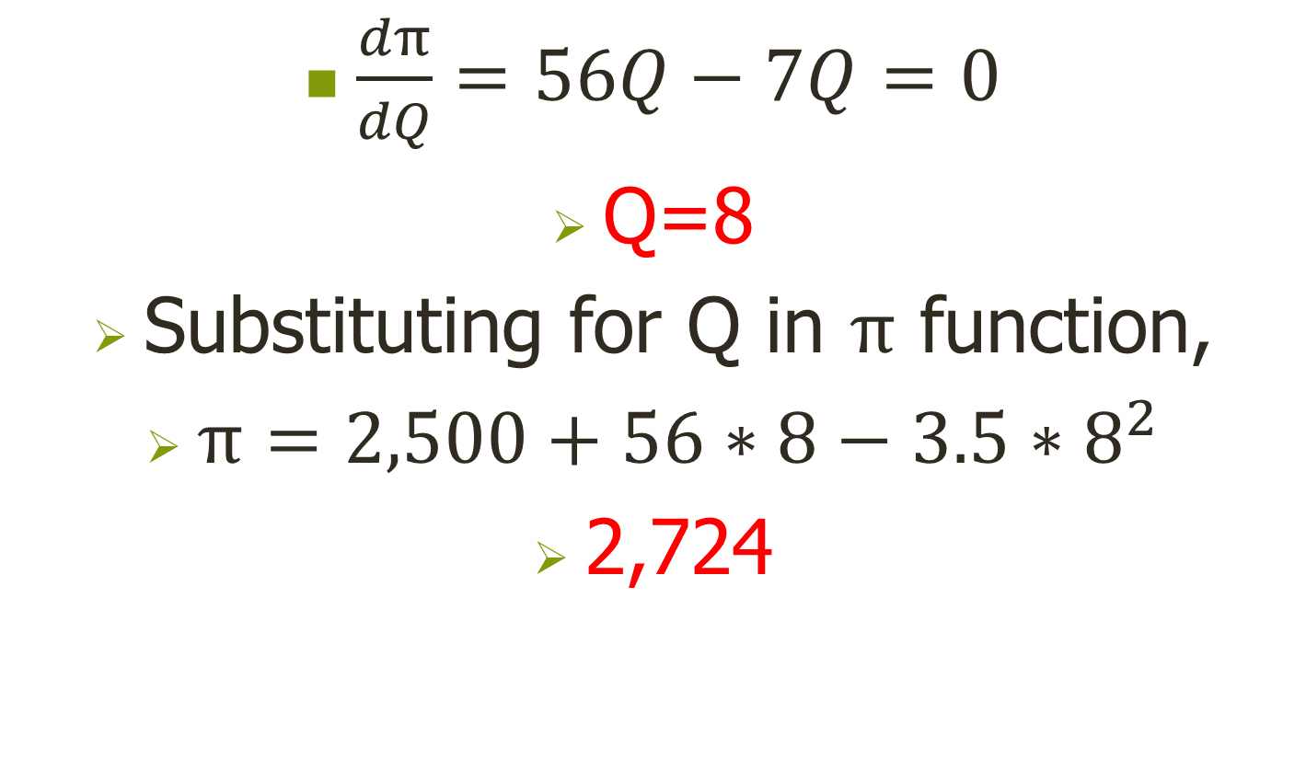
Numerical example: solution
$\frac{dπ}{dQ}=56Q−7Q=0$
Q=8
Substituting for Q in $π$ function,
$π=2,500+56∗8−3.5{∗8}^{2}$
2,724

Slide 43
PROFIT SCENARIOS
Types of profit:
Abnormal (Supernormal)profits
Normal profits
Negative profit(Losses)
May also be categorized as:
Accounting profit: π= TR-TC
Economic profit: π = TR-(TC+OC of inputs)

Slide 44
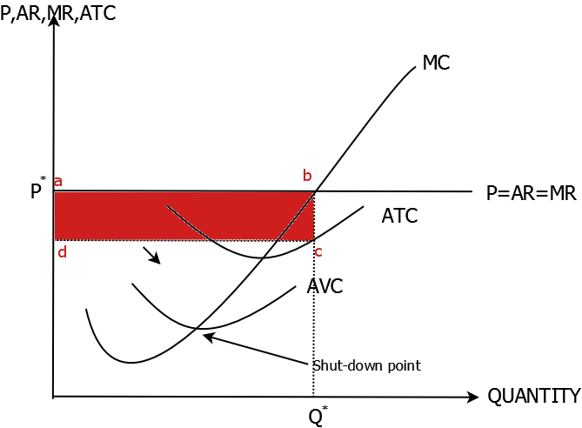
ABNORMAL PROFITS

Slide 45
ABNORMAL PROFITS ‘ctd
Firms make profit when Average total cost (ATC) curve is below the marginal revenue curve. i.e P>min ATC.
in the short run ,Positive economic profits provide firms with an incentive to enter the market, so as to take advantage of the abnormal profits existing in the markets.

Slide 46
ABNORMAL PROFITS ‘ctd
In the long run , entry of more firms exerts a downward pressure on the extant market price.
The downward pressure acts as a disincentive for firms, leading to them cutting back on output, leading to decreased profits.
Thus in LR, no abnormal profits. Only zero profits.

Slide 47
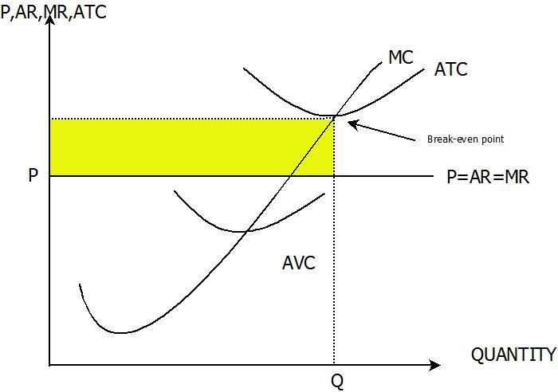
NEGATIVE PROFITS(LOSSES)

Slide 48
NEGATIVE PROFITS(LOSSES) ctd
Occurs when the firm’s minimum of the average total cost curve lies above its marginal revenue curve at the profit maximizing level of output. P<min ATC
Decision maker faced with two options in this scenario:
Reduce or stop production
Shut down

Slide 49
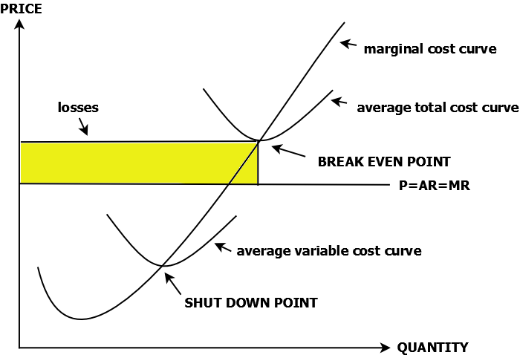
Reduce/Stop Production
If the minima of the AVC curve <marginal revenue firms are advised NOT to shut down in the short run.
This is coz when min AVC<MR, the firm is able to cover its Variable Cost + a portion of its fixed costs.

Slide 50
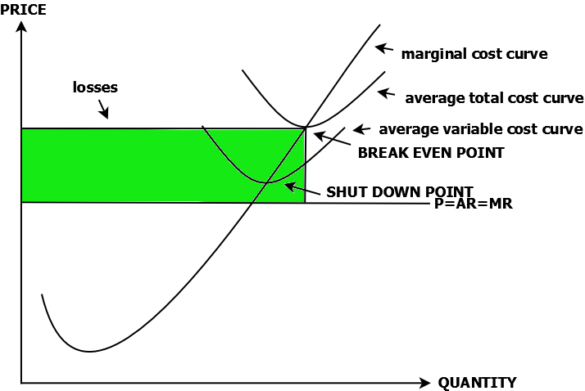
Shut down Point
Def: The point at which a firm in PC market will be indifferent between continuing pxn and shutting down.
when the minima of the AVC is more than the firm’s Marginal Revenue, the firm is advised to shutdown as its not able to cover its VC.

Slide 51
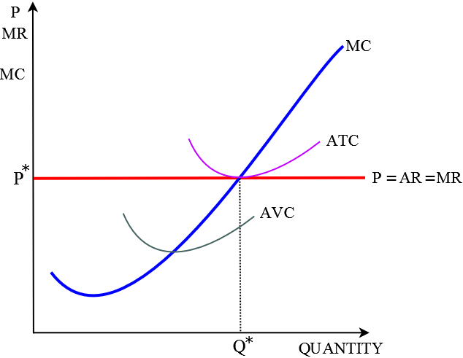
ZERO PROFIT SCENARIO

Slide 52
Determining the Monopolist’s Price and Output
Price
MC
Monopolist price
$36
30
24
18
12
6
D
0
1
2
3
4
5
6
7
8
9
10
6
12
MR

Slide 53
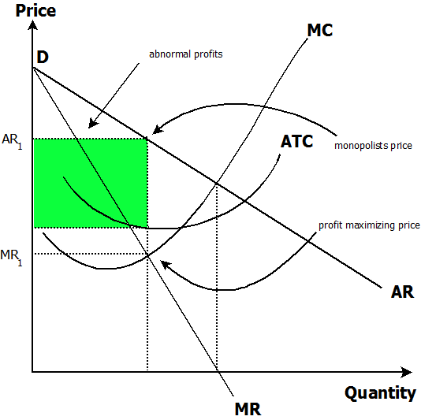
Π MAXIMIZATION IN MONOPOLIES: Positive profits (Abnormal, Supernormal)
MONOPOLY PROFIT MAX.ppt

Slide 54
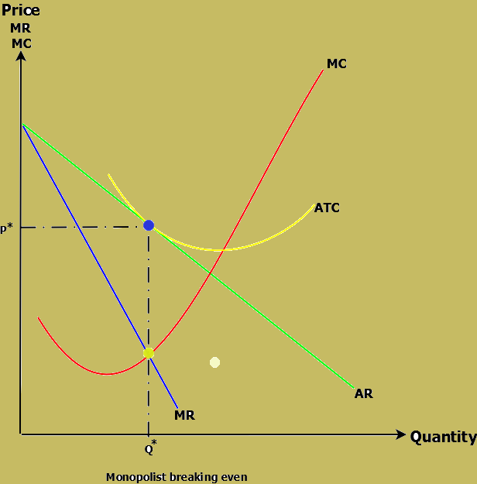
Π MAXIMIZATION IN MONOPOLIES: Zero profits (Normal)

Slide 55
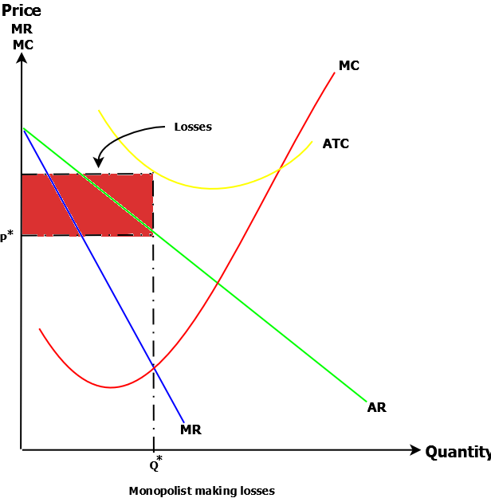
Π MAXIMIZATION IN MONOPOLIES: Negative profits (Subnormal, Losses)

